Slide 1
How do I sit?

Slide 2
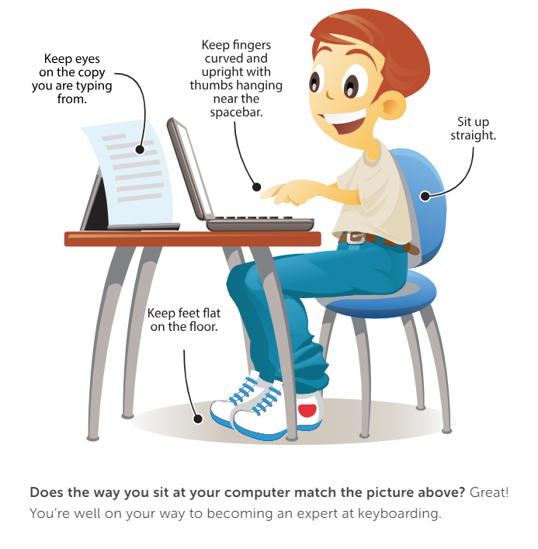

Slide 3
Complete How Do I Sit Review Packet

